Slide 1
JavaScript Profiling and Optimization on V8
Yilin Zhang C. Vic Hu

Slide 2
About JavaScript
ECMAScript
Used in Adobe Flash, Mac OS Dashboard widgets, Yahoo! widgets, browser bookmarklets, etc.
Client-side scripting, DOM manipulation, Ajax

Slide 3
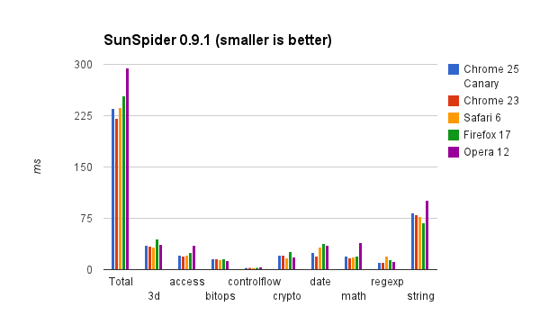

Slide 4
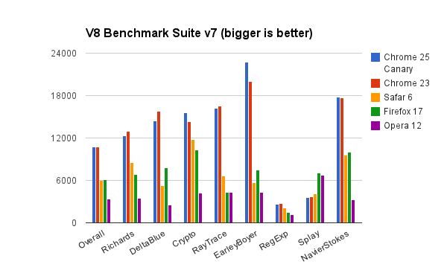

Slide 5

V8
Open source JS engine by Google
Written in C++ and used in Chrome
Implements ECMAScript (ECMA-262, 5E)
Can run standalone or embedded in any C++ applications
Designed to be fast and efficient, like a V8 engine should be

Slide 6
What makes V8 so fast?
Fast property access
Dynamic machine code
Efficient garbage collection

Slide 7
Fast Property Access
JS is a dynamic language
Hidden class vs. dictionary lookup
High degree of structure-sharing

Slide 8
Fast Property Access
JS is a dynamic language
Hidden class vs. dictionary lookup
High degree of structure-sharing

Slide 9
Hidden Class
Created dynamically behind the scene
Changed when a new property is added

Slide 10
function Point(x, y) {
this.x = x;
this.y = y;
}
*example borrowed from https://developers.google.com/v8/design

Slide 11
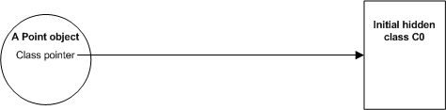
function Point(x, y) {
this.x = x;
this.y = y;
}

Slide 12
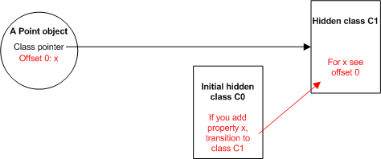
function Point(x, y) {
this.x = x;
this.y = y;
}

Slide 13
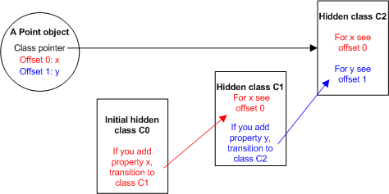
function Point(x, y) {
this.x = x;
this.y = y;
}

Slide 14
Advantages of using hidden class
No dictionary lookup for property access
Enable V8 to use inline caching

Slide 15
Inline Cache (IC)
Caches type-dependent code
Needs to validate type assumptions
Changed at runtime

Slide 16
Dynamic Machine Code
Directly compiled into machine code
No intermediate byte code or interpreter
Inline caching for correct prediction on hidden classes

Slide 17
Efficient Garbage Collection
Stops program execution
Processes only part of the object heap
Accurate objects and pointers locating in memory to avoid memory leaks

Slide 18
V8 Compilation Process
Base compiler
Runtime profiler
Optimizing compiler
Deoptimization support

Slide 19
1. Base Compiler
A full compiler to generate machine code upon execution
No assumption about types at compilation time
Uses ICs to retrieve types at runtime
Fast, but not optimized

Slide 20
2. Runtime Profiler
Sampling every milliseconds
In preparation for the optimization

Slide 21
3. Optimizing Compiler
SSA form
Loop-invariant code motion
Common subexpression elimination
Linear-scan register allocation
Function inlining

Slide 22
4. Deoptimization Support
What if overly optimistic?
An opportunity to 'bail-out'
Easily observed with the profiler

Slide 23
JavaScript is Slow
Problem:
Compute the 25,000th prime
Algorithm:
For x = 1 to infinity: if x not divisible by any member of an initially empty list of primes, add x to the list until we have 25,000
[2012 Google I/O]

Slide 24
The Contenders
c++
JavaScript
class Primes {
public:
int getPrimeCount() const { return prime_count; }
int getPrime(int i) const { return primes[i]; }
void addPrime(int i) { primes[prime_count++] = i; }
bool isDivisibe(int i, int by) { return (i % by) == 0; }
bool isPrimeDivisible(int candidate) {
for (int i = 1; i < prime_count; ++i) {
if (isDivisibe(candidate, primes[i])) return true;
}
return false;
}
private:
volatile int prime_count;
volatile int primes[25000];
};int main() {
Primes p;
int c = 1;
while (p.getPrimeCount() < 25000) {
if (!p.isPrimeDivisible(c)) {
p.addPrime(c);
}
c++;
}
printf("%d\n", p.getPrime(p.getPrimeCount()-1));
}
function Primes() {
this.prime_count = 0;
this.primes = new Array(25000);
this.getPrimeCount = function() { return this.prime_count; }
this.getPrime = function(i) { return this.primes[i]; }
this.addPrime = function(i) {
this.primes[this.prime_count++] = i;
}
this.isPrimeDivisible = function(candidate) {
for (var i = 1; i <= this.prime_count; ++i) {
if ((candidate % this.primes[i]) == 0) return true;
}
return false;
}
};function main() {
p = new Primes();
var c = 1;
while (p.getPrimeCount() < 25000) {
if (!p.isPrimeDivisible(c)) {
p.addPrime(c);
}
c++;
}
print(p.getPrime(p.getPrimeCount()-1));
}
main();

Slide 25
class Primes {
public:
int getPrimeCount() const { return prime_count; }
int getPrime(int i) const { return primes[i]; }
void addPrime(int i) { primes[prime_count++] = i; }
bool isDivisibe(int i, int by) { return (i % by) == 0; }
bool isPrimeDivisible(int candidate) {
for (int i = 1; i < prime_count; ++i) {
if (isDivisibe(candidate, primes[i])) return true;
}
return false;
}
private:
volatile int prime_count;
volatile int primes[25000];
};int main() {
Primes p;
int c = 1;
while (p.getPrimeCount() < 25000) {
if (!p.isPrimeDivisible(c)) {
p.addPrime(c);
}
c++;
}
printf("%d\n", p.getPrime(p.getPrimeCount()-1));
}

Slide 26
function Primes() {
this.prime_count = 0;
this.primes = new Array(25000);
this.getPrimeCount = function() { return this.prime_count; }
this.getPrime = function(i) { return this.primes[i]; }
this.addPrime = function(i) {
this.primes[this.prime_count++] = i;
}
this.isPrimeDivisible = function(candidate) {
for (var i = 1; i <= this.prime_count; ++i) {
if ((candidate % this.primes[i]) == 0) return true;
}
return false;
}
};function main() {
p = new Primes();
var c = 1;
while (p.getPrimeCount() < 25000) {
if (!p.isPrimeDivisible(c)) {
p.addPrime(c);
}
c++;
}
print(p.getPrime(p.getPrimeCount()-1));
}main();

Slide 27
The Results
% g++ primes.cc -o primes
% time ./primes287107
real 0m2.955s
user 0m2.952s
sys 0m0.001s
% time d8 primes.js287107
real 0m15.584s
user 0m15.612s
sys 0m0.073s
c++
JavaScript
C++ is about 5x faster than JavaScript

Slide 28
Inline Caches
Candidate % this.primes[i]
No calls in this code

Slide 29
Inline Caches
Candidate % this.primes[i]
this.primes[i]
->call LoadIC_Initialize
-> call 0x311286e0
-> move eax, [edi+0fx]

Slide 30
Logging What Gets Optimized
Command:
./out/ia32.release/d8 --trace-opt samples/primes.js
Log name of optimized functions to stdout:
addPrime, IsPrimDivisible, main...

Slide 31
Profiling the JavaScripts
./out/ia32.release/d8 samples/primes.js --prof
287107
./tools/mac-tick-processor v8.log

Slide 32
Profiling the JavaScripts
Statistical profiling result from v8.log, (10868 ticks, 81 unaccounted, 0 excluded).
[JavaScript]:
ticks total nonlib name
1254 11.5% 11.5% LazyCompile: *main samples/primes.js:18
959 8.8% 8.8% LazyCompile: MOD native runtime.js:238
643 5.9% 5.9% Stub: CEntryStub
468 4.3% 4.3% KeyedLoadIC: A keyed load IC from the snapshot
388 3.6% 3.6% Stub: BinaryOpStub_MOD_Alloc_SMI+Oddball
1 0.0% 0.0% LazyCompile: ~Primes.isPrimeDivisible samples/primes.js:10
[C++]:
ticks total nonlib name
3274 30.1% 30.1% _atanhl$fenv_access_off
1301 12.0% 12.0% v8::internal::Runtime_NumberMod
979 9.0% 9.0% v8::internal::Heap::NumberFromDouble

Slide 33
Something is Wrong with the Code
this.isPrimeDivisible = function(candidate) {
for (var i = 1; i <= this.prime_count; ++i) {
if ((candidate % this.primes[i]) == 0) return true;
}
return false;
}Profiling Again
/out/ia32.release/d8 samples/primes.js --prof
287107
./tools/mac-tick-processor v8.log

Slide 34
Profiling Again
[JavaScript]:
ticks total nonlib name
1426 99.4% 99.4% LazyCompile: *main samples/primes-2.js:18
5 0.3% 0.3% LazyCompile: *Primes.isPrimeDivisible samples/primes-2.js:10
[C++]:
ticks total nonlib name
1 0.1% 0.1% v8::internal::StaticVisitorBase::GetVisitorId
1 0.1% 0.1% v8::internal::Runtime_FunctionSetName
1 0.1% 0.1% v8::internal::Map::LookupDescriptor
1 0.1% 0.1% v8::internal::LAllocator::TraceAlloc

Slide 35
Runtime
time v8 primes-2.js
287107
real 0m1.829s
user 0m1.827s
sys 0m0.010s

Slide 36
Optimize Your Algorithm
this.isPrimeDivisible = function(candidate) {
for (var i = 1; i < this.prime_count; ++i) {
var current_prime = this.primes[i];
if (current_prime * current_prime > candidate) {
return false;
}
if ((candidate % current_prime) == 0) return true;
}
return false;
}

Slide 37
Optimize Your Algorithm
time v8 primes-3.js
287107
real 0m0.044s
user 0m0.038s
sys 0m0.004s

Slide 38
Crankshaft
Hydrogen-SSA in Crankshaft [Wingolog]
1. To permit inlining. Inlining is truly the mother of all optimizations, in that it permits more optimizations to occur.
2. To facilitate loop-invariant code motion and common subexpression elimination.

Slide 39
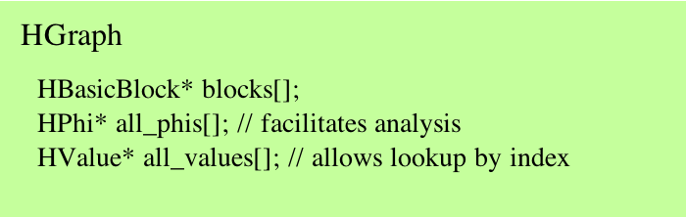
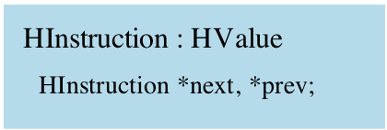
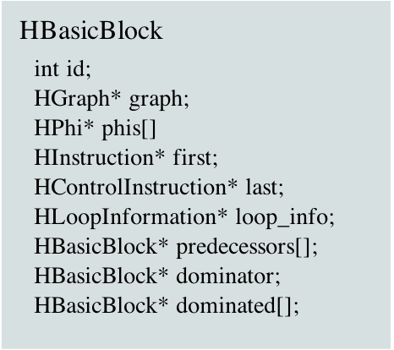
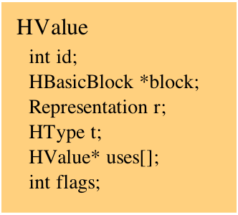
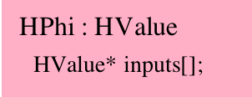
SSA Data Structures

Slide 40
Optimization Proposal
More sophisticated algorithms in determining the 'hot code': frequency alone might not be the best way to define 'hot'
  Use counter instead of sampling every millisecond
Phi node insertion optimization

Slide 41
Conclusion
Chrome with V8 engine outperforms other browsers in most benchmarks, especially V8 benchmarks
Hidden classes introduces inline caching and type assumption
Use run-time profiling to optimize hot code, and do nothing if the profiler decided it's not hot

